Slide 1
Research Impact

Slide 2
Thinking about the impact of your research
What impact do you want your research to have?
How do you plan to achieve that impact?

Slide 3
Lack of agreement…
The majority of respondents (60%) indicated that journal rankings and lists, including Impact Factors, probably did not (20%), definitely did not (8%), or might or might not (32%) reflect scholarly impact.
However, the top five indicators of scholarly impact on a five-point scale were:
Scholarly articles in top-tier journals – 4.49
Scholarly citations to research – 4.21
Scholarly books – 3.94
Competitive research grants – 3.93
Articles in practitioner-oriented/industry publications – 3.88.
Respondents saw the top five research audiences as:
Other academics in management – 4.48
Top management and decision-makers in companies – 4.26
Government and policymakers – 4.08
Other academics in the social sciences – 4.06
Students – 4.0.
Yet, about 54% of the survey’s respondents considered impact on practice as either strongly important (31%) or intensely important (23%); only 7% viewed impact on practice as not at all important as a component of scholarly impact.
Beyond Impact Factors: an Academy of Management report on measuring scholarly impact - LSE Impact

Slide 4

The purpose of research?
Research for whose sake?
Research for research’s sake?
Research for outputs or research for outcomes?
Business school research? Is it primarily for business’s sake?
To what extent does it reflect the needs/demands of stakeholders?

Slide 5
Context
Political climate – universities increasingly seen as providers not only of student education but also as providers of service to industry, commerce and government
Economic climate – Likelihood of squeeze on finances, static or even falling research income (from all research sponsors)
Socio-cultural climate – What will societies/nations expect of universities in future?
What do we think as scholars? – What kind of business school and university do we believe in?

Slide 6
Defining Quality: Not all outputs count…
4 (World-leading):* Highest standard of originality, significance, and rigour.
3 (Internationally excellent):* High quality, just below 4* standards.
2 (Internationally recognised):* Quality that is recognised at an international level.
1 (Nationally recognised):* Quality that is recognised at a national level.

Slide 7
Defining Quality: Not all outputs count…
ABS Journal Ranking 2024 - Journal Ranking Portal
50 Journals used in FT Research Rank
ABDC-JQL-2025-v1-260326.xlsx
Journal Citation Reports – Journals
Scopus – Sources
Google Scholar Metrics

Slide 8
The purpose of management research? Four positions
academic understanding
relevance through applied research
Double hurdle (academic rigour and managerial relevance)
critique of management (research as social critique)
Notes:
2

Slide 9
Why should we invest in management research?
The Economist (2007) asked why we should invest enormous sums ($320m in the US alone) in scientific management research when these studies are not relevant and ‘highly quantitative, hypothesis-driven and esoteric’.
UK Minister of HE: What are these journals and what is their purpose?
The Economist 2007 “Practically irrelevant” 28 August. Available from http:www.economist.com/node/9707498.
Vicari, S. 2013 Is the problem only ours? A question of relevance in management research?, European Management Review 10: 173-181

Slide 10
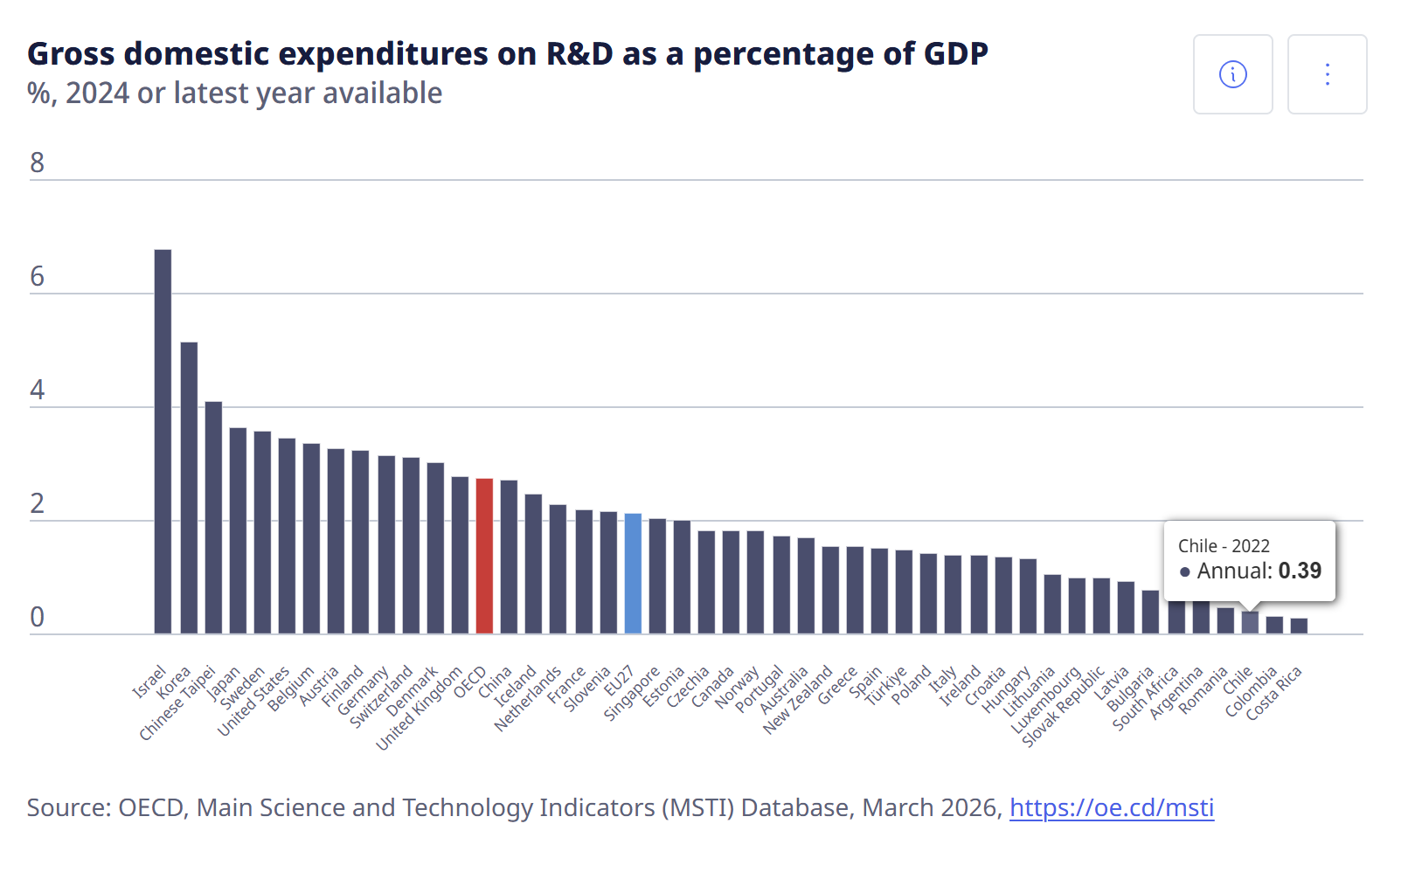

Slide 11

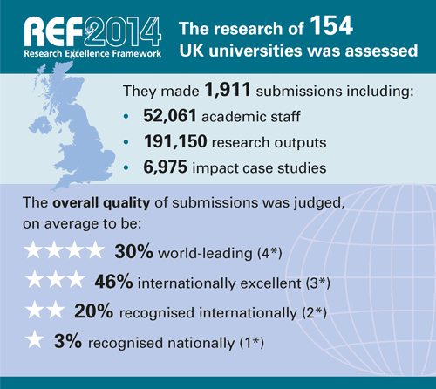
Importance of external research evaluation
Evaluation is conducted regularly through publication and through periodic peer review – national research quality audit.
Impact is defined as an effect on, change or benefit to the economy, society, culture, public policy or services, health, the environment or quality of life, beyond academia.

Slide 12
Impact Framework: Reach and Significance
Reach = “the extent and/or diversity of the beneficiaries of the impact … assessed in terms of the extent to which the potential … beneficiaries have been reached”
Significance = “the degree to which the impact had enabled, enriched, influenced, informed or changed the performance, policies, practices, products, services, understanding, awareness, or wellbing of the beneficiaries”
“Each case study must provide a clear and coherent narrative that includes an account of who or what audiences, constituencies or groups, organisations, places, publics, sectors and so on, have benefited. Been influenced of acted upon. … the key claims made in the narrative [must] be supported by evidence”

Slide 13
Impact Types
Instrumental - Influencing the development of policy practice or service provision; shaping behaviour; altering legislation, etc.
Conceptual – Contributing to our understanding of the above; Reframing debates
Capacity-building – Technical/professional skills development
Cultural change – Increased willingness to engage in knowledge exchange activities; Changed mindsets
Enduring connectivity – establishment of enduring academic/non-academic relationships

Slide 14
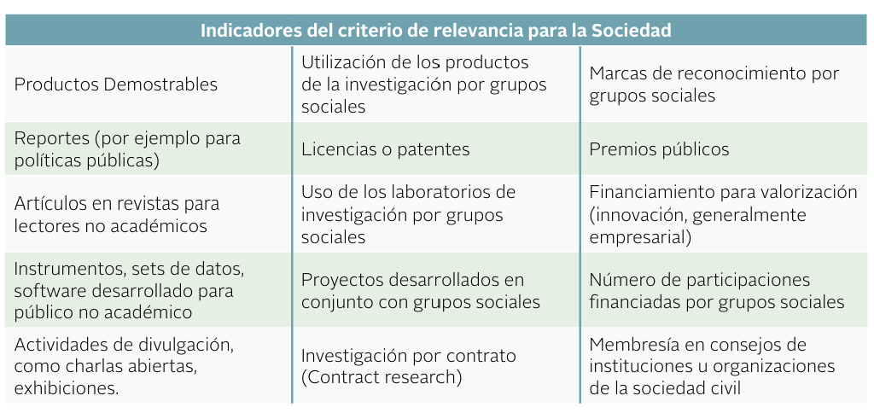
Examples of impact categories
Source: Revisión de Sistemas de Evaluación de Impacto no Académico de la Investigación a Nivel Internacional – Plataforma Documental

Slide 15
Back to you…
Instrumental: Changing policy/practice.
Conceptual: Reframing debates.
Capacity-building: Skill development.
Cultural change: Changing mindsets.
Enduring connectivity: Long-term relationships.
Have you identified which indicator would be the most ambitious yet achievable for your specific PhD project?

Slide 16
Building your strategy
Create networks with practitioners (key individuals, key organisations)
Build the principle of partnership into your research
Just as your doctoral journey is about creating relationships for future research and publication, create relationships with end-users
Co-production of research
Co-funding if possible
Social capital, communication & long-term relationships
Co-publication? (Practitioner journals, Harvard Business Review)

Slide 17
Generating impact
Co-production:
Involving users at all stages of the research
Well-planned user-engagement and knowledge exchange strategies
Co-production of knowledge – scope for generating higher impact
Portfolios of research activity that build reputations with research users
Relationships:
Established relationships and networks with user communities
Where appropriate, the involvement of intermediaries and knowledge brokers as translators, amplifiers, network providers, etc.
Good infrastructure and management support

Slide 18
Danger!!! Engagement or Irrelevance?
Danger of marginalisation of the research role
More impact or more emphasis on teaching and marginalisation
Private universities, corporate universities and consulting firms could displace business schools
Danger of “disruptive innovation” (Clayton Christensen)- online providers? http://www.economistinsights.com/content/disruption-higher-education

Slide 19
Pathways to Impact
What is your research purpose?
What is the research context?
How can I best satisfy stakeholders?
What opportunities will I provide for them to benefit from research?
Answer = produce good, impactful research that is publishable in good journals and interest stakeholders beyond academia
Challenge = develop a multi-dimensional research strategy for the future

Slide 20
The future of research?
Future will not support present focus on pure research to the neglect of relevance
Shift in nature of teaching market toward professional & executive education
Research needs to be aligned with practice & impact
Impact justifies research funding

